Slide 1
GO Team
Business Meeting #2
Where we are – Where we’re going

Slide 2


Where We Are
Our strategic plan is the guide for the work we’re doing in the school. By monitoring the plan and ranking priorities, we can all work towards the common goals. Using the priorities in the strategic plan, the school leadership team developed a Continuous Improvement Plan (CIP) for the current school year.

Slide 3
Timeline for GO Teams
You are HERE
Fall 2021
GO Team Developed 2021-2025 Strategic Plan
1
Summer 2024
School Leadership completed Needs Assessment and defined overarching needs for SY22-23
2
August 2024
School Leadership completed 2024-2025 Continuous Improvement Plan
3
Sept. – Dec. 2024
Utilizing current data, the GO Team will review & possibly update the school strategic priorities and plan
4
Before Winter Break
GO Team will take action (vote) on the rank of the strategic plan priorities for SY24-25 in preparation for budget discussions.
5

Slide 4
Discussion Items
Current Strategic Plan
Georgia Milestones Math Data
(previously discussed, met target goal)
Continuous Improvement Plan
Needs Assessment
SMART GOALS
Action Plan
Strategic Plan Alignment & Update
School Uniform

Slide 5
Current
Strategic Plan
2021-2025

Slide 6
West Manor IB World School
SMART Goals
Increase the % of grades 3-5 students scoring proficient or above on Milestones/ MAP in reading by 3%
Increase the % of grades 3-5 students scoring proficient or above on Milestones/MAP in math by 3%
Increase the percentage of students with 10 or less absences by 3%
APS Strategic Priorities & Initiatives
School Strategic Priorities
School Strategies
Fostering Academic Excellence for All
Data
Curriculum & Instruction
Signature Program
1.
3.
1A. Implementation of an intervention block to reduce gaps in learning
1B. Employ a literacy block with phonics for grades k-2
1C. Create PLC planning time for teachers to internalize standards and plan for instruction
Increase student phonic awareness and create early readers
Increase student knowledge in numbers and operations domain
Increase student multiplication skills
Building a Culture of Student Support
Whole Child & Intervention
Personalized Learning
Increase student attendance and decrease suspension rate
TBD: Create an attendance team to monitor and address attendance concerns, Create a Care Team to address student needs
TBD: Utilize SLC practices and restorative justice with the Counselor to reduce suspensions
Equipping & Empowering Leaders & Staff
Strategic Staff Support
Equitable Resource Allocation
Increasing Teacher knowledge of Standards
Increase Teacher knowledge of IB Program
TBD: Monthly IB training for staff, Professional development individualized around teacher needs in reading and math, training for phonics program (Fundations)
Ongoing PD for SEL, restorative practices, and trauma
Creating a System of School Support
Collective Action, Engagement & Empowerment
TBD: Conduct data meetings in PLC, with parents and students. Students will also have goal setting meetings with teachers
--Increase Parent Liaison and Social Worker positions to full time to support the needs of students and parents
Improve stakeholder knowledge of school data and how to assist
Provide support to students and stakeholders in need

Slide 7
Data

Slide 8
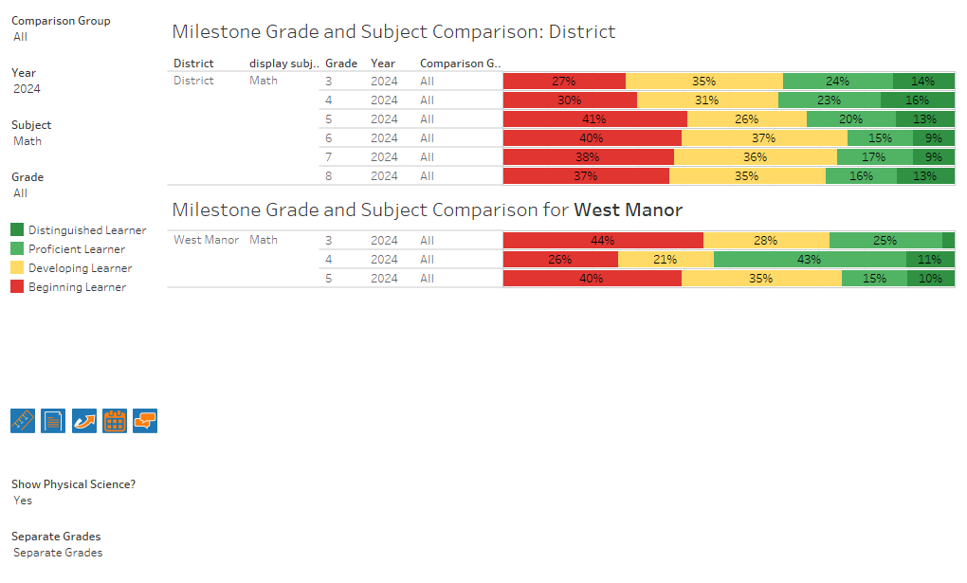
GA Milestones Math Results

Slide 9

GO Team Discussion:
Data Protocol
What do you notice?
What are your wonderings?
Based on our school’s trend data from MAP assessments and end-of-year test assessments, which student sub-groups and grade levels showed the most significant gaps or unexpected trends?
Based on our school’s trend data from MAP assessments, Milestones and other indicators, are there specific trends that require more focused attention?
What additional questions do you have?

Slide 10
Continuous Improvement Plan

Slide 11
Notes:
Notes for School CIP Teams: After completing your Comprehensive Needs Assessment ( data protocol), you will come here and identify some strengths and opportunities/challenges you have observed from the data. The priority areas are Literacy, Numeracy, and Whole Child & Student Support. Identify an overarching need for each area. Formulate a problem statement for each area. Make sure the problem statement meets the criteria. Refer to your CIP resources.

Slide 18
GO Team
Activity
&
Discussion
GO TEAM DISCUSSION: Review the priorities and goals in your strategic plan and the information and goals CIP. Reflect on if updates need to be made to the Strategic Plan.
Are all CIP Goals reflected in
our Strategic Plan Priorities?
If not, which CIP Goal(s) are missing and should be added to the Strategic Plan?

Slide 19

Updates to the
Strategic Plan
Enter all changes/updates to your plan – be sure to include accountability measures, as appropriate.

Slide 20
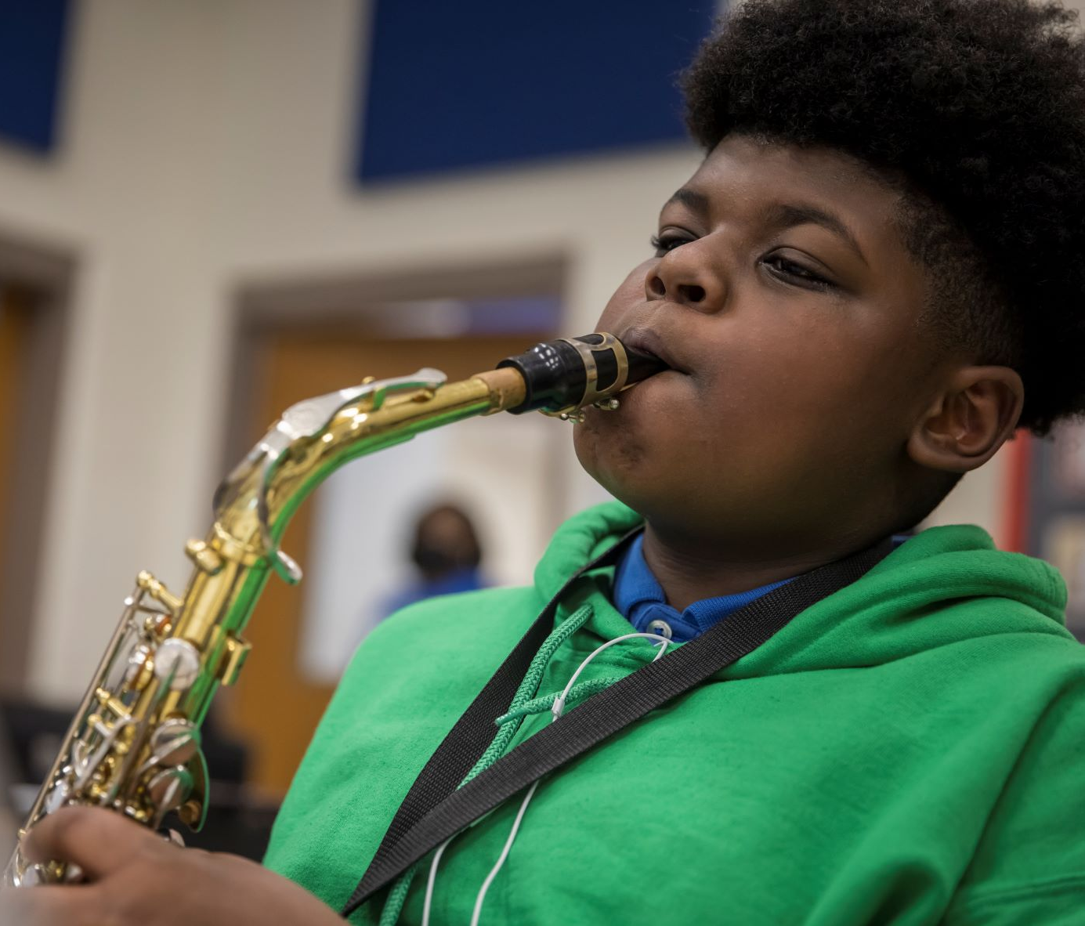

Where we’re going
At our next meeting(s) we will discuss how our data is aligning to our strategic plan and determine if we need to make any adjustments.
Before the end of Fall Semester, we will take Action (vote) on any updates to our strategic plan and the ranking our strategic priorities for the 2024-2025 school year.
Let me or the Chair know of any additional information you need for our future discussion.

Slide 21
Principal’s Report

Slide 22

Security Grant Update
$45,000 will be utilized to hire a Security Guard for West Manor

Slide 23
Thank you

